Slide 1
DATABASE MANAGEMENT SYSTEMS
Jeevan Raksha
Pharmacy Management System
A MySQL Mini Project — Database Design, Data Management & SQL Query Analysis
Presented by: Matcha Sai Satish Chandra Kumar
MySQL Workbench

Slide 2
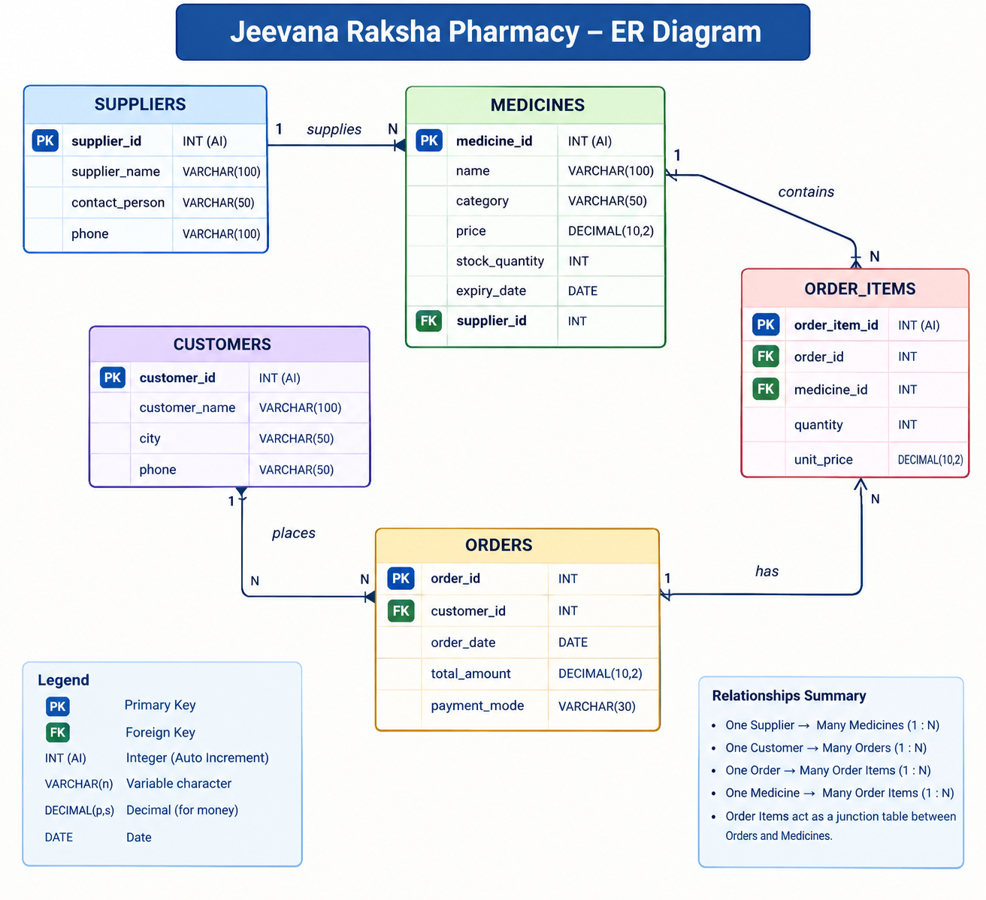
Entity-Relationship Overview
Conceptual relationships between the five core tables.
Customers
PK customer_id
customer_name, city, phone
Orders
PK order_id
FK customer_id
Suppliers
PK supplier_id
supplier_name, phone
Order Items
PK order_item_id
FK order_id, medicine_id
Medicines
PK medicine_id
FK supplier_id
One customer can place many orders. Each order contains order items. Each item references a medicine, and each medicine is linked to a supplier.
Jeevan Raksha Pharmacy | MySQL Mini Project
6

Slide 3
Introduction
A relational database project for organizing pharmacy operations.
Jeevan Raksha Pharmacy Management System is designed to store and retrieve pharmacy data in a structured way.
CUSTOMERS
SUPPLIERS
MEDICINES
Customer names, cities and contact details
Supplier details and medicine sources
Medicine type, price, expiry and stock
ORDERS
ORDER ITEMS
Order dates, totals and payment modes
Medicines and quantities included in each order
Jeevan Raksha Pharmacy | MySQL Mini Project
2

Slide 4
Problem Statement & Solution
Why a structured pharmacy database is useful.
PROBLEM
SOLUTION
• Manual stock tracking can be error-prone
• Supplier and medicine details may be scattered
• Finding customer orders and payment totals takes time
• Low-stock medicines may be missed
• Store related information in MySQL tables
• Link medicines to their suppliers
• Track orders and order items consistently
• Use SQL queries for reports and low-stock checks
Jeevan Raksha Pharmacy | MySQL Mini Project
3

Slide 5
Objectives of the Project
What the database is intended to achieve.
OBJECTIVE 01
OBJECTIVE 02
Maintain centralized customer and supplier records
Store medicine prices, expiry dates and stock quantities
OBJECTIVE 03
OBJECTIVE 04
Record orders, payment modes and order details
Retrieve information using filtering conditions
OBJECTIVE 05
OBJECTIVE 06
Summarize revenue and quantities using aggregate functions
Identify low-stock medicines and supplier details
Jeevan Raksha Pharmacy | MySQL Mini Project
4

Slide 6
DBMS Concepts Implemented
Core relational database and SQL concepts used in the project.
ER MODELING
PRIMARY KEY
FOREIGN KEY
Entities, attributes and relationships
Unique identity for each record
Links related records between tables
DDL
DML
AGGREGATION & JOIN
CREATE TABLE and ALTER TABLE
INSERT and manage sample records
COUNT, SUM, GROUP BY, HAVING and JOIN
Jeevan Raksha Pharmacy | MySQL Mini Project
5

Slide 7
Database Schema — Master Tables
Main reference data used by the pharmacy database.
CUSTOMERS
SUPPLIERS
MEDICINES
customer_id (PK)
customer_name
city
phone
supplier_id (PK)
supplier_name
contact_person (if present)
phone
medicine_id (PK)
name / name
category
price,
stock_quantity
expiry_date
supplier_id (FK)
Column labels should match the actual table definitions in MySQL Workbench.
Jeevan Raksha Pharmacy | MySQL Mini Project
7

Slide 8
Database Schema — Transactional Tables
Tables that record orders and the medicines included in them.
ORDERS
ORDER_ITEMS
order_id (PK)
customer_id (FK)
order_date
total_amount
payment_mode
order_item_id / item_id (PK)
order_id (FK)
medicine_id (FK)
quantity
unit_price
Foreign keys connect each order to a customer and each order item to an order and a medicine.
Jeevan Raksha Pharmacy | MySQL Mini Project
8

Slide 9
Sample Data
Representative records used to test the database queries.
MEDICINE EXAMPLES
ORDER EXAMPLES
Paracetamol Tablet — ₹25 — Stock: 100
Cough Syrup — ₹80 — Stock: 40
Vitamin C Tablet — ₹60 — Stock: 75
Amoxicillin Capsule — ₹120 — Stock: 30
Insulin Injection — ₹250 — Stock: 20
Order 1 — ₹550 — UPI
Order 2 — ₹300 — Cash
Order 3 — ₹1,200 — Card
Order 4 — ₹450 — UPI
Order 5 — ₹800 — Cash
Sample values are illustrative and should be adjusted if your final database contains different records.
Jeevan Raksha Pharmacy | MySQL Mini Project
9

Slide 10
SQL Query Analysis — Basic Retrieval
Filtering records using SELECT and WHERE.
Query 1 — Display customer names and cities
SELECT customer_name, city
FROM customers;
Query 2 — Find medicines that are syrup or injection
SELECT *
FROM medicines
WHERE medicine_type IN ('Syrup', 'Injection');
Jeevan Raksha Pharmacy | MySQL Mini Project
10

Slide 11
Filtering & Aggregate Queries
WHERE, COUNT and GROUP BY.
Query 3 — Orders above ₹500
Query 4 — Count medicines supplied by Apollo Distributors
SELECT *
FROM orders
WHERE total_amount > 500;
SELECT COUNT(*) AS total_medicines
FROM medicines m
JOIN suppliers s
ON m.supplier_id = s.supplier_id
WHERE s.supplier_name = 'Apollo Distributors';
Query 5 — Revenue by payment mode
SELECT payment_mode, SUM(total_amount) AS total_revenue
FROM orders
GROUP BY payment_mode;
Jeevan Raksha Pharmacy | MySQL Mini Project
11

Slide 12
JOIN Queries
Combine related data from more than one table.
Query 6 — Customer name, order date and total amount
SELECT c.customer_name, o.order_date, o.total_amount
FROM orders o
JOIN customers c ON o.customer_id = c.customer_id;
Query 7 — Low-stock medicines with supplier names
SELECT m.medicine_name, m.stock_quantity, s.supplier_name
FROM medicines m
JOIN suppliers s ON m.supplier_id = s.supplier_id
WHERE m.stock_quantity < 50;
Jeevan Raksha Pharmacy | MySQL Mini Project
12

Slide 13
Sales & Customer Analysis
Aggregate calculations using SUM, GROUP BY and HAVING.
Query 8 — Best-selling medicine by total quantity
SELECT m.medicine_name, SUM(oi.quantity) AS total_quantity_sold
FROM order_items oi
JOIN medicines m ON oi.medicine_id = m.medicine_id
GROUP BY m.medicine_id, m.medicine_name
ORDER BY total_quantity_sold DESC
LIMIT 1;
Query 9 — Customers who spent more than ₹1,000
SELECT c.customer_name, SUM(o.total_amount) AS total_spent
FROM customers c JOIN orders o ON c.customer_id = o.customer_id
GROUP BY c.customer_id, c.customer_name
HAVING SUM(o.total_amount) > 1000;
Jeevan Raksha Pharmacy | MySQL Mini Project
13

Slide 14
Results & Conclusion
What the project demonstrates.
• Customer and supplier details can be stored in structured tables.
• Medicine stock and expiry details can be retrieved with SQL.
• Orders can be filtered by amount and grouped by payment mode.
• JOIN queries connect customer, order, medicine and supplier data.
• Aggregate queries help identify sales patterns and low-stock medicines.
KEY TAKEAWAY
MySQL makes pharmacy information easier to organize, search and summarize.
Jeevan Raksha Pharmacy | MySQL Mini Project
14

Slide 15
THANK YOU
Jeevan Raksha Pharmacy Management System
MySQL Mini Project

